Slide 1
problem formulation of system model

Slide 2
Hello!
We are G8
You can find us at
abdelrahman.gelany@student.guc.edu.eg
& mohamed.abdelmaksod@student.guc.edu.eg
& mohamed.diyah@student.guc.edu.eg

Slide 3
“Network planning is the process of designing a telecommunication network that satisfies some customer requirements and maximizes or minimizes a network operator requirement based on some constraints”

Slide 4
Problem formulation content
Type of the optimization of the objective function
Objective function
Decision variables
Constraints

Slide 5

PAPER ONE.

Slide 6
1.paper one
Multiobjective optimization based on self-organizing
Particle Swarm Optimization algorithm for massive MIMO
5G wireless network

Slide 7

PAPER ONE
DECISION VARIABLE
The optimization parameters are x = ${[K M P_{t} ]}^{T}$.
where M BS antenna, K users and the transmitting power
P_{t} for each cell.

Slide 8
PAPER ONE
-OPTIMIZATION TYPE :
MAXIMIZATION
-OBJECTIVE FUNCTION:
max {F(x)} where F(x) =[F1(x),F2(x),F3(x),F4(x)]
, F1(x) represents an objective function for average user rate, F2(x)
denotes the objective function for average area rate, F3(x) describes the objective function for energy efficiency, and F4(x) is the objective function for spectral efficiency. Generally, the objective functions conflicting with one another in
MOOP and single solution sets are produced by considering trade-off conflicts among the objectives.
The optimization parameters are x = [K M Pt]^{T}. where M BS antenna, K users and the transmitting power
Pt for each cell.

Slide 9
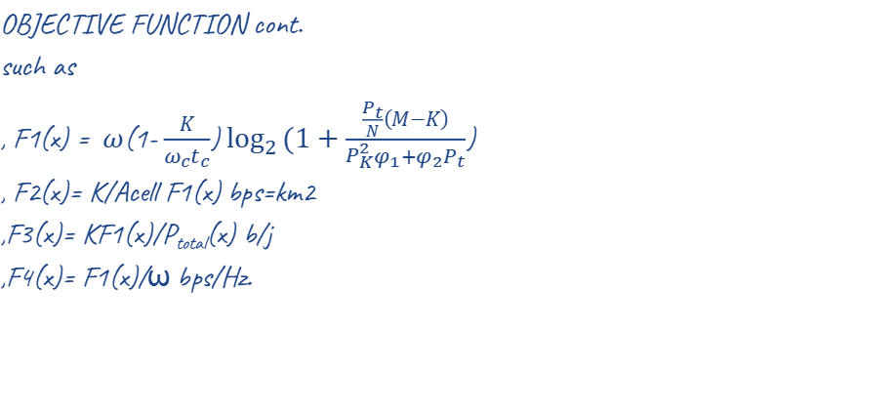
PAPER ONE
OBJECTIVE FUNCTION cont.
such as
, F1(x) = $ω$(1- $\frac{K}{{ω_{c}t}_{c}}$)$\log_{2}{(1+\frac{\frac{P_{t}}{N}\left(M−K\right)}{P_{K}^{2}φ_{1}{+φ}_{2}P_{t}}}$)
, F2(x)= K/Acell F1(x) bps=km2
,F3(x)= KF1(x)/P_{total}(x) b/j
,F4(x)= F1(x)/ω bps/Hz.

Slide 10
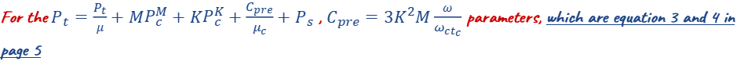
PAPER ONE
where ω and ωc represent transmitting bandwidth and bandwidth of coherence respectively, tc represents coherence time, P²_{n} represents average noise power, Ψ₁ denotes inverse channel loss, and ψ₂ is intercell interference strength. The term ωc, tc explains about required overhead to acquire channel, Pt/K denotes average transmitting power of a user, M − K denotes efficient array gain, and P²_{n}Ψ1 +P_{t}Ψ2 denotes average degradation due to interference and noise.
For the $P_{t}=\frac{P_{t}}{μ}+MP_{c}^{M}+KP_{c}^{K}+\frac{C_{pre}}{μ_{c}}+P_{s}$ , $C_{pre}=3K^{2}M\frac{ω}{ω_{ct_{c}}}$ parameters, which are equation 3 and 4 in page 5

Slide 11
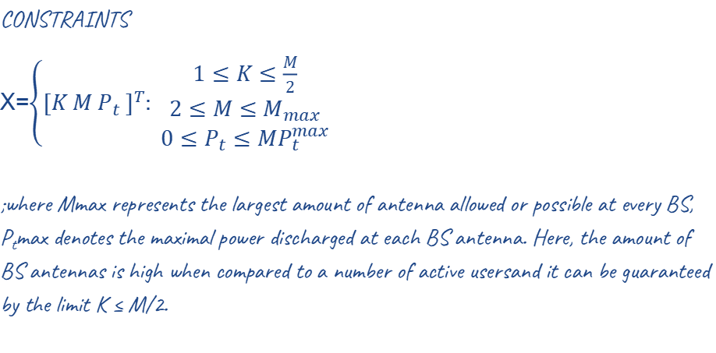
PAPER ONE
CONSTRAINTS
X=$\left\{{[K M P_{t} ]}^{T}: \begin{aligned}1≤K≤\frac{M}{2} \\ 2≤M≤M_{max} \\ 0≤P_{t}≤MP_{t}^{max}\end{aligned}\right.$
;where Mmax represents the largest amount of antenna allowed or possible at every BS, P_{t}max denotes the maximal power discharged at each BS antenna. Here, the amount of BS antennas is high when compared to a number of active usersand it can be guaranteed by the limit K ≤ M/2.

Slide 12
PAPER TWO.

Slide 13
2.paper Two
Bi-SON: Big-Data Self Organizing Network for
Energy Efficient Ultra-Dense Small Cells

Slide 14

PAPER TWO
DECISION VARIABLE
$$α_{q}∈\left\{0 | 1\right\}$$
>if the small cell q is in the sleeping mode ,so $α$ = 0
>if the small cell q is in the active mode ,so $α$ = 1

Slide 15
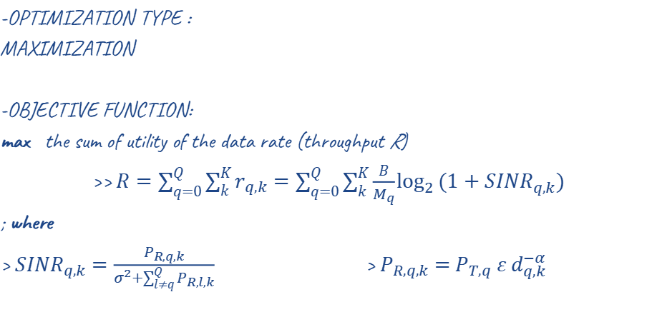
PAPER TWO
-OPTIMIZATION TYPE :
MAXIMIZATION
-OBJECTIVE FUNCTION:
max the sum of utility of the data rate (throughput R)
>> $R=\sum_{q=0}^{Q}{\sum_{k}^{K}{r_{q,k}}}=\sum_{q=0}^{Q}{\sum_{k}^{K}{\frac{B}{M_{q}}\log_{2}{(1+{SINR}_{q,k})}}}$
; where
> ${SINR}_{q,k}$ $=\frac{P_{R,q,k}}{σ^{2}+\sum_{l≠q}^{Q}{P_{R,l,k}}}$ > $P_{R,q,k}$ $=$ $P_{T,q} ε d_{q,k}^{−α}$
Such that the parameters are Q,N,Mq,B. where Q small cell and K users besides Mq represent the number of served users in the samll cell q. B is the bandwidth of each small cell . The spectral efficiency of the user k which is served by the small cell q can be expressed $\log_{2}{(1+{SINR}_{q,k})}$

Slide 16
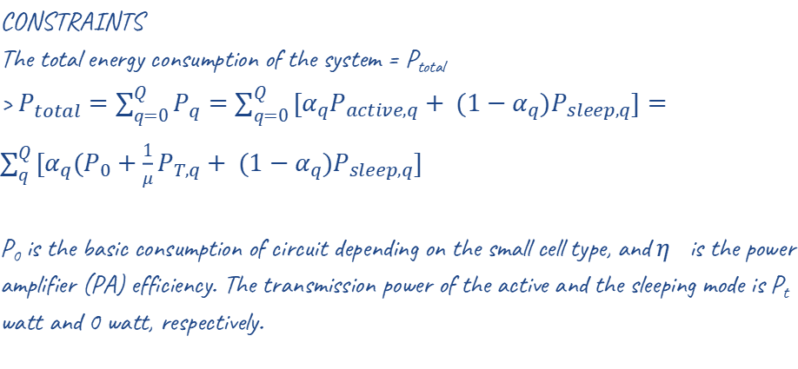
PAPER TWO
CONSTRAINTS
The total energy consumption of the system = P_{total}
> $P_{total}=\sum_{q=0}^{Q}{P_{q}=\sum_{q=0}^{Q}{[α_{q}P_{active,q}+ (1−α_{q})P_{sleep,q}]}}=\sum_{q}^{Q}{[α_{q}({P_{0}+\frac{1}{μ}P}_{T,q}+ (1−α_{q})P_{sleep,q}]}$
P₀ is the basic consumption of circuit depending on the small cell type, and 𝜂 is the power amplifier (PA) efficiency. The transmission power of the active and the sleeping mode is P_{t} watt and 0 watt, respectively.

Slide 17
PAPER THREE.

Slide 18
3.paper Three
Energy-efficient SON-based user-centric backhaul
scheme

Slide 19
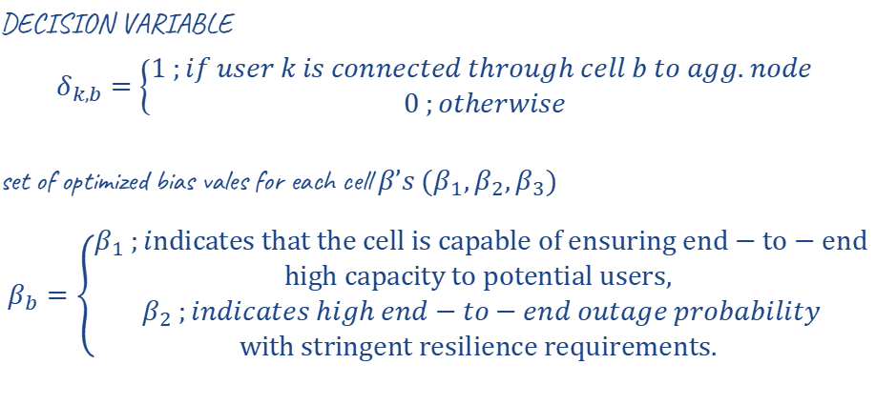
PAPER THREE
DECISION VARIABLE
$$δ_{k,b}=\left\{\begin{aligned}1 ;if user k is connected through cell b to agg. node \\ 0 ;otherwise\end{aligned}\right.$$
set of optimized bias vales for each cell $β’s (β_{1},β_{2},β_{3})$
$$β_{b}=\left\{\begin{aligned}β_{1} ;indicates that the cell is capable of ensuring end−to−end \\ high capacity to potential users, \\ β_{2} ;indicates high end−to−end outage probability \\ with stringent resilience requirements. \end{aligned}\right.$$

Slide 20
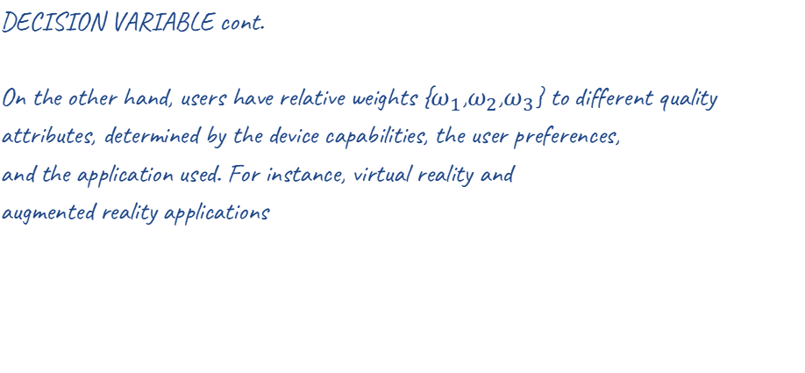
PAPER THREE
DECISION VARIABLE cont.
On the other hand, users have relative weights {$ω_{1}$,$ω_{2}$,$ω_{3}$} to different quality attributes, determined by the device capabilities, the user preferences,
and the application used. For instance, virtual reality and
augmented reality applications

Slide 21
PAPER THREE
-OPTIMIZATION TYPE :
MINIMIZATION
-OBJECTIVE FUNCTION:
Minimise the number of last-mile links attached between aggregation point and the nine small cells

Slide 22
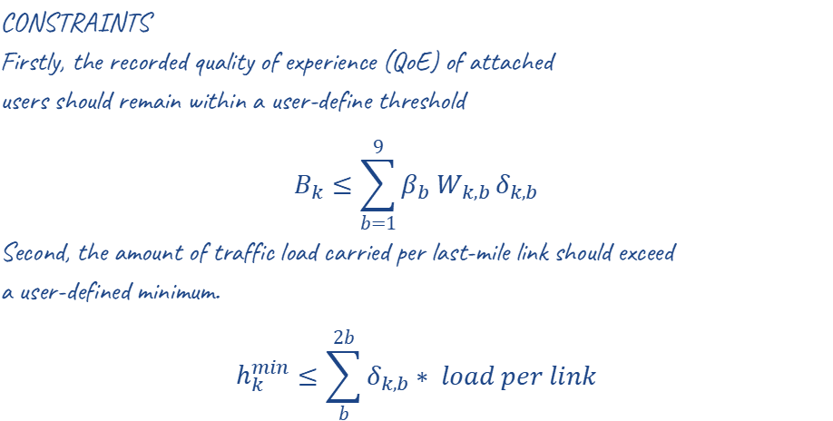
PAPER THREE
CONSTRAINTS
Firstly, the recorded quality of experience (QoE) of attached
users should remain within a user-define threshold
$$B_{k}≤\sum_{b=1}^{9}{β_{b} W_{k,b}}δ_{k,b}$$
Second, the amount of traffic load carried per last-mile link should exceed
a user-defined minimum.
$$h_{k}^{min}≤\sum_{b}^{2b}{δ_{k,b}}∗ load per link$$
Such that the parameters are C,K,b,W,B. where C small cell and K users besides b links, W weights per user and the cells’ broadcast bias values B, load per link is to be calculated from the erlang table

Slide 23

PAPER THREE
CONSTRAINTS cont.
Thirdly, the legitimate constraints
$$B_{k}>0$$
$$W_{k,b}≥0$$

Slide 24
Thanks!
For any abiguities?
You can find us at
abdelrahman.gelany@student.guc.edu.eg
& mohamed.abdelmaksod@student.guc.edu.eg
& mohamed.diyah@student.guc.edu.eg

